Slide 1


CS3811 Project Work / Internship Anna University Viva Voce Examination 30-05-2025 and 31-05-2025 Semester 8
OM SAKTHI
ADHIPARASAKTHI ENGINEERING COLLEGE
MELMARUVATHUR - 603319
DEPARTMENT OF COMPUTER SCIENCE AND ENGINEERING
INTEGRATED SYSTEM OF SOLAR TRACKING, LI-FI TECHNOLOGY AND INDUSTRIAL ENERGY AUTOMATION FOR SMART SUSTAINABLE SOLUTIONS
Presented By,
Jayanthi M (420421104030)
Swathi E (420421104078)
Swetha N (420421014081)
Guided By,
Ms. T.M. Padmapriya
AP/CSE

Slide 2
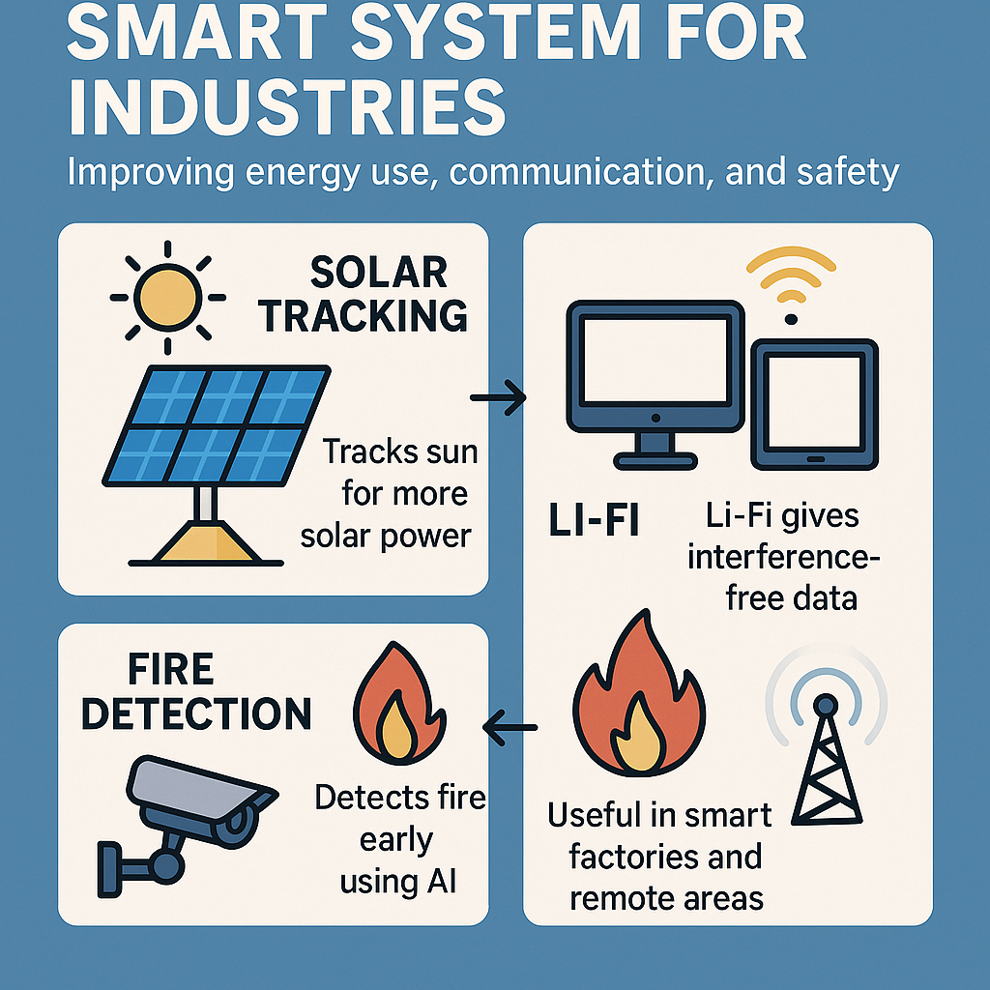
Introduction
Industries need better energy use, faster communication, and safety. Current systems are static, slow, or manual.This project builds a smart system using solar tracking, Li-Fi, and fire detection to improve energy use, communication, and safety.
→Tracks sun for more solar power →Li-Fi gives interference-free data →Detects fire early using AI →Useful in smart and remote areas

Slide 3
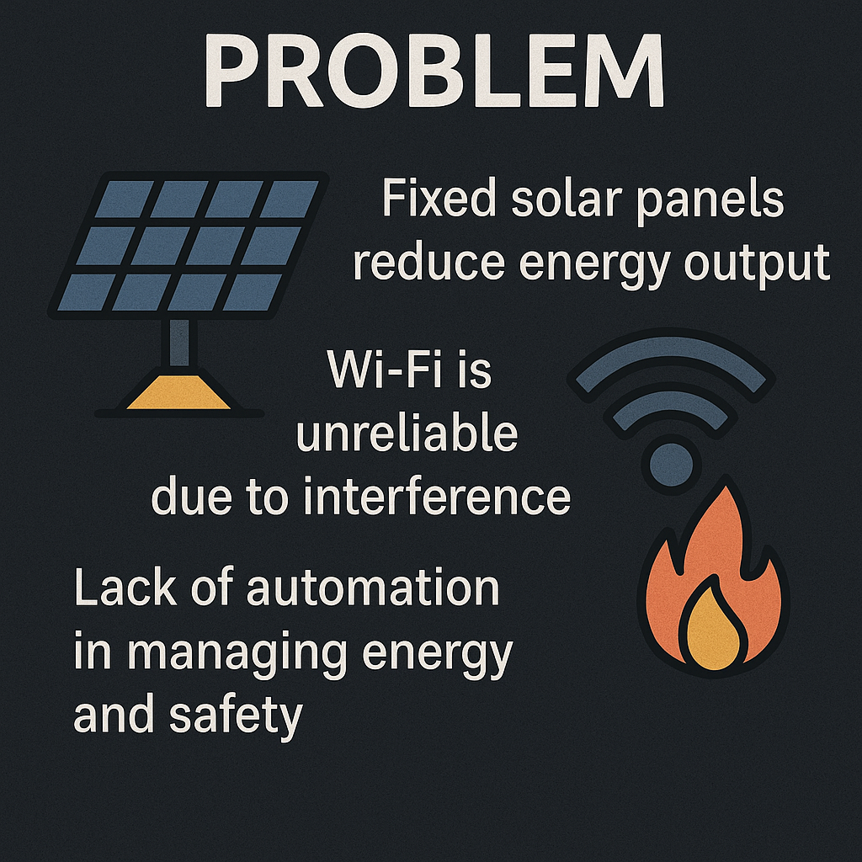
Problem Statement
Fixed solar panels reduce energy output, Wi-Fi is unreliable due to interference, and fire detection systems are often slow. There's also a lack of automation in managing energy and safety.
This project focuses on combining solar tracking, Li-Fi communication, and AI-based fire detection. It stays within energy, communication, and safety areas, mainly for industrial use.

Slide 4
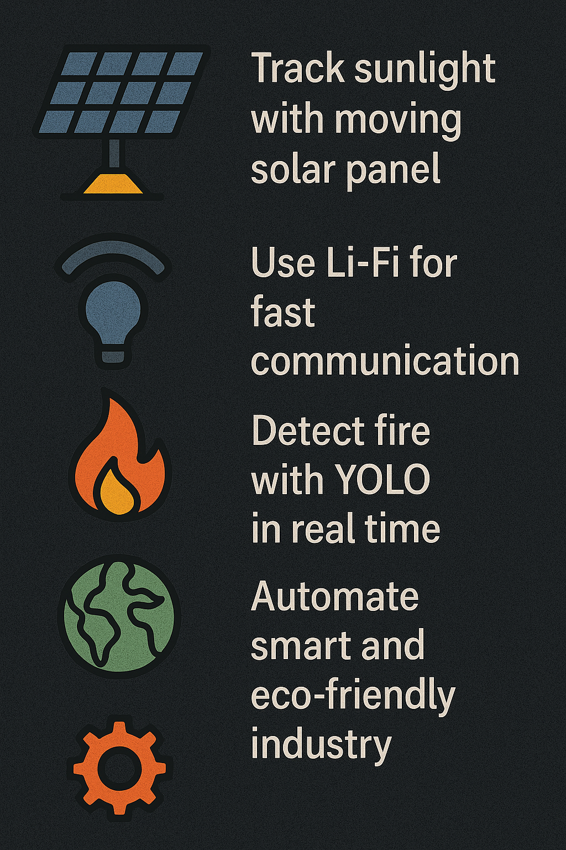
Objectives
Track sunlight to boost solar energy using a moving panel system with sensors
Use Li-Fi for fast, secure, and interference-free communication
Detect fire in real-time using YOLO for better safety
Automate energy and safety systems with Arduino
Promote smart, eco-friendly, and self-sustaining industrial operations and automations
Reduce manual monitoring and improve system efficiency

Slide 5
Literature Survey
S.no | Title | Comparison with your solution | Gaps Identified
1 | Li-Fi Enabled IoT Framework for Industrial Communication (2025) enables energy-efficient and seamless data transfer using Li-Fi and IoT protocols. | Your system integrates Li-Fi for fire detection alerts, but not focused on industrial communication. | Degrades with high-density network traffic; lacks robustness for varied environments.
2 | Multi-Sensor Integration for Smart Fire Safety (2025) uses sensor fusion (Smoke, IR, Gas) and YOLOv8 to improve fire detection reliability. | Closely aligns with your fire detection module using multiple sensors and YOLO. | Complexity in managing diverse sensor data; integration challenge persists.
3 | Fire Detection in Solar Systems (2025) identifies hazards using YOLO and thermal sensors, and sends real-time alerts. | Directly relates to your YOLO and thermal sensor-based fire detection module. | May produce false positives from temperature changes or reflections.
4 | Edge-Based Solar Monitoring System (2024) focuses on reducing latency in solar monitoring using edge computing and IoT | Similar in terms of real-time monitoring and control objectives. | Limited processing capacity on edge devices restricts scalability

Slide 6
Literature Survey Contd.
S.no | Title | Comparison with your solution | Gaps Identified
5 | AI-Powered Predictive Maintenance for Solar Panels (2024) uses ML and sensor fusion to predict panel failures and reduce downtime. | Your solution focuses on fire detection, not predictive maintenance. | Needs large training datasets and is not suitable for sudden anomalies like fires.
6 | IoT-based Smart Solar Tracking System (2024) aims to enhance solar energy efficiency using IoT and real-time data. | Your system includes solar tracking, but also integrates Li-Fi and fire detection. | Limited accuracy under extreme weather conditions affects performance.
7 | Li-Fi Technology for Data Transmission (2024) ensures fast, interference-free wireless communication using Li-Fi. | Your system uses Li-Fi for real-time alert communication | Dependent on line-of-sight; prone to obstruction issues.
8 | AI-Driven Solar Optimization (2024) enhances tracking precision by integrating AI models with real-time data | Your solar tracking doesn’t currently optimize using AI | AI model accuracy depends on continuous updates for weather adaptation

Slide 7
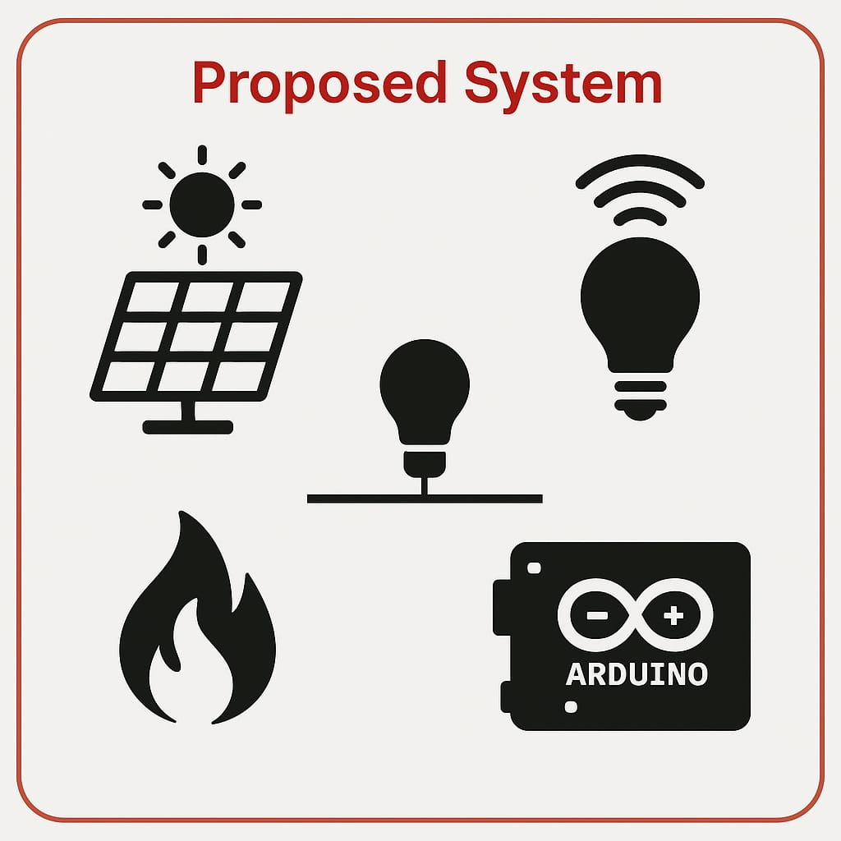
Proposed System
A smart, eco-friendly system that combines automated solar tracking, Li-Fi-based high-speed communication, YOLO-powered fire detection, and Arduino-based energy management to enhance safety, efficiency, and sustainability.
Innovations include the fusion of Li-Fi with solar systems for faster and more secure communication, the use of YOLO for instant fire hazard alerts, and a low-cost, scalable design using open-source tools. The system supports renewable energy usage and promoting a sustainable and intelligent energy solution.

Slide 8
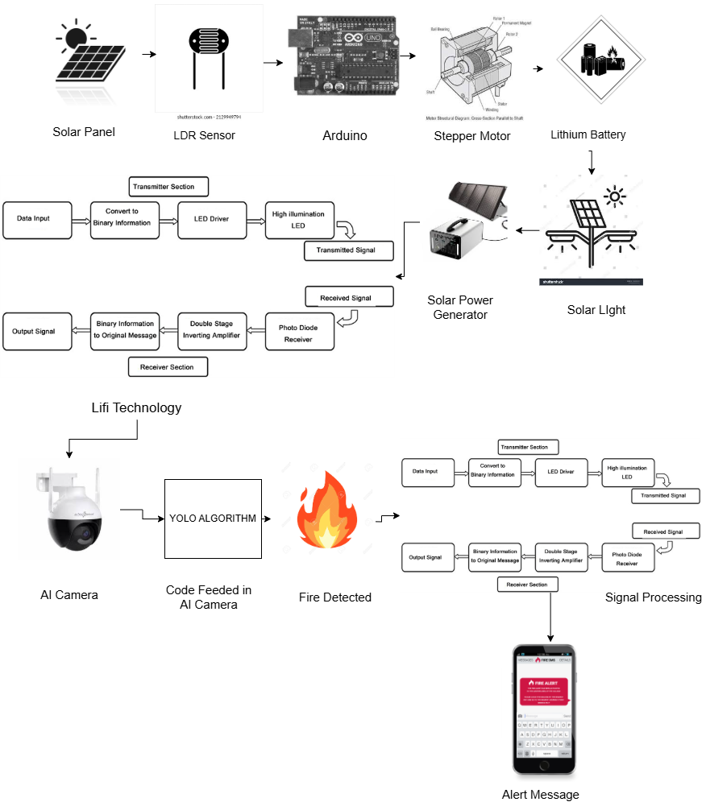
System Architecture

Slide 9
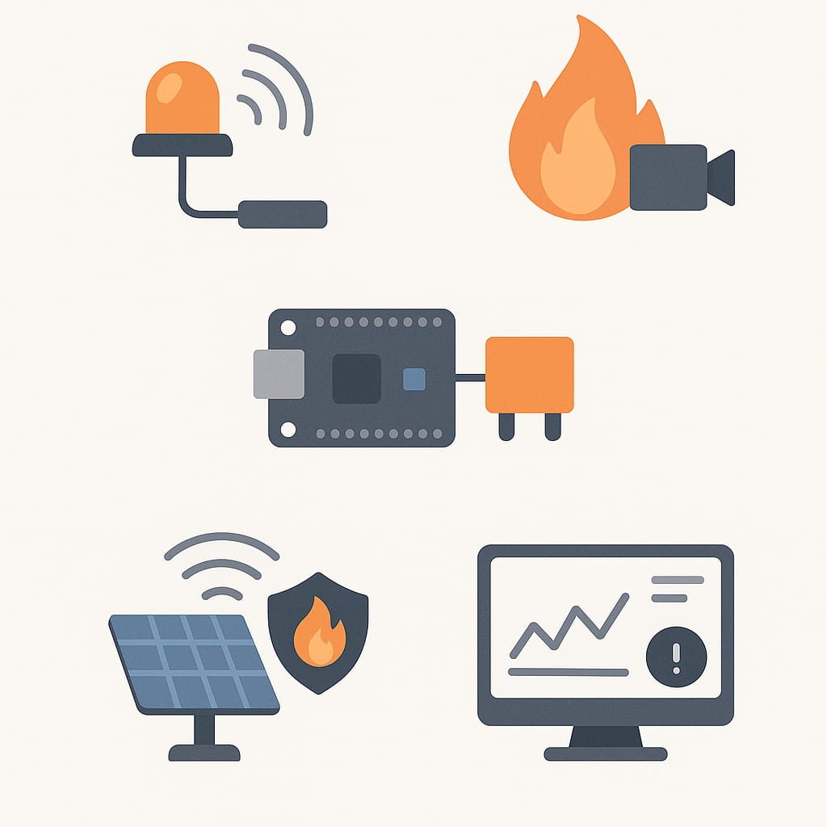
System Modules
Li-Fi Communication Module : Sends data quickly and using LED light, without signal interference.
Fire Detection Module : Uses AI (YOLO) to spot fire instantly and trigger safety actions.
Automation Module : Controls devices and loads automatically using Arduino and relays.
Smart Integration of Solar SafetyCommunication : Combines solar tracking, Li-Fi data transfer, YOLO-based fire detection for fast, and safe operation.
Monitoring Interface : Shows live system data and alerts on an easy-to-use dashboard.

Slide 10
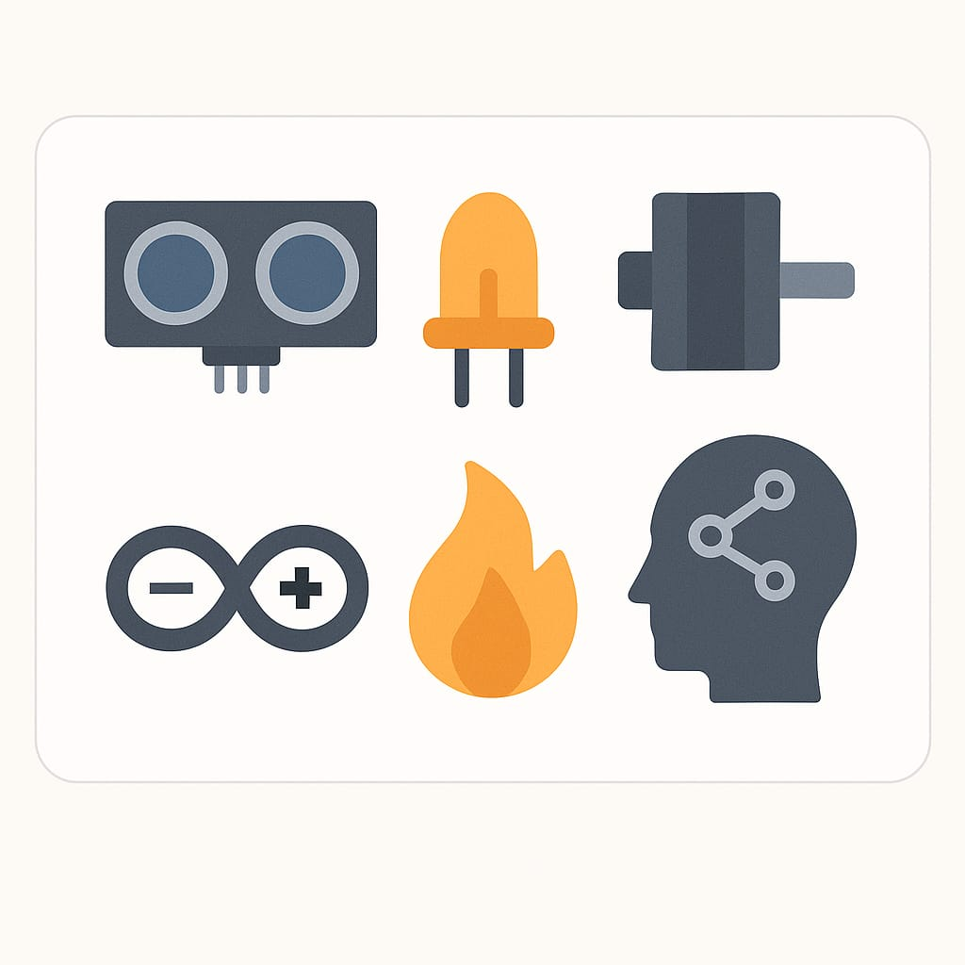
Methodology / Technology Used
Used Python for fire detection with YOLO
Used Arduino to control hardware and automation
Employed sensors, LEDs, stepper motors, and relays for tracking, lighting, and control
Followed Agile methodology with step-by-step development and weekly testing/improvements
Developed hardware and software in parallel
Used YOLOv8 as the AI model for fire detection
Used Arduino platform for automation and control

Slide 11
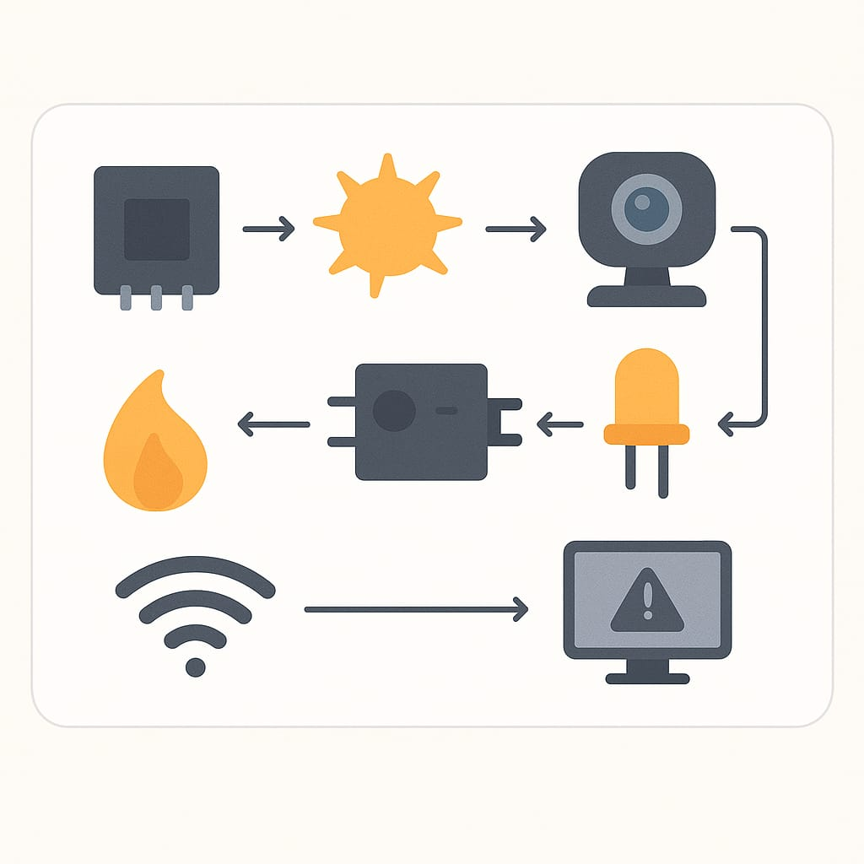
Implementation
Initialize Arduino, sensors, and Li-Fi communication modules
Continuously read sunlight sensors to adjust solar panel
position via stepper motor for optimal tracking
Use Python with YOLOv8 to analyze camera feed for
real-time fire detection upon fire detection trigger alert
signals and activate safety
Transmit data and alerts through Li-Fi technology using LEDs as transmitters
Li-Fi ensures secure, high-speed communication between system components
System runs continuously, combining hardware control and AI-based fire detection with wireless data transfer
Developed and tested modules incrementally following Agile methodology

Slide 12
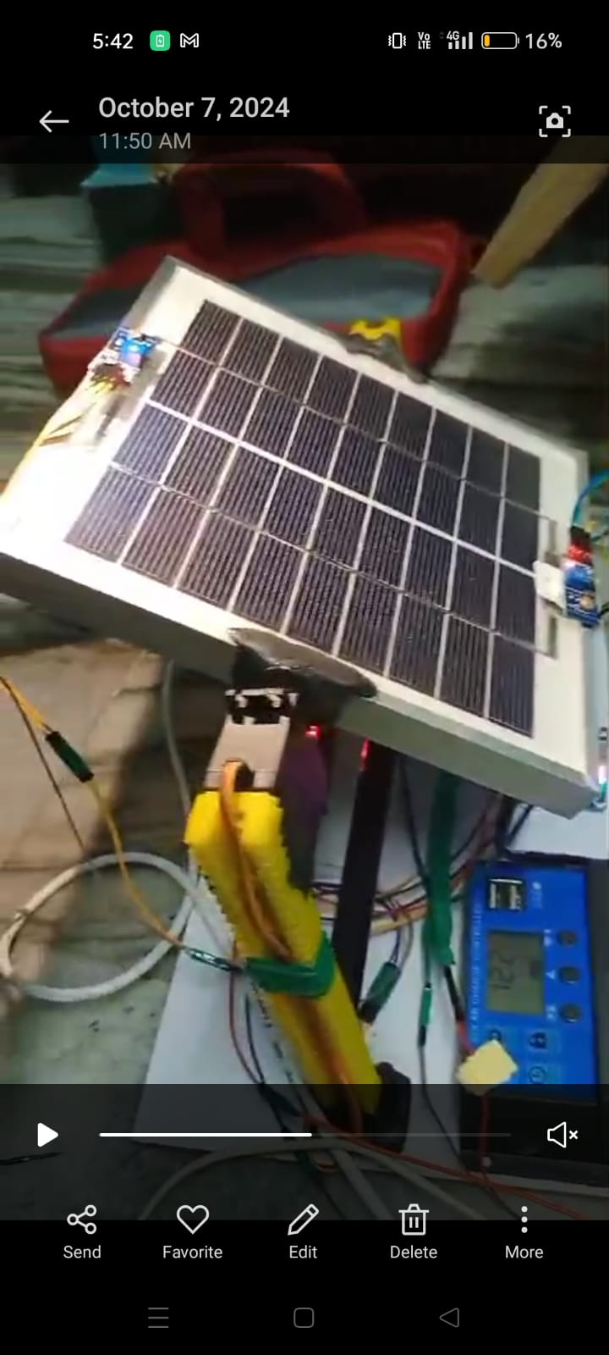
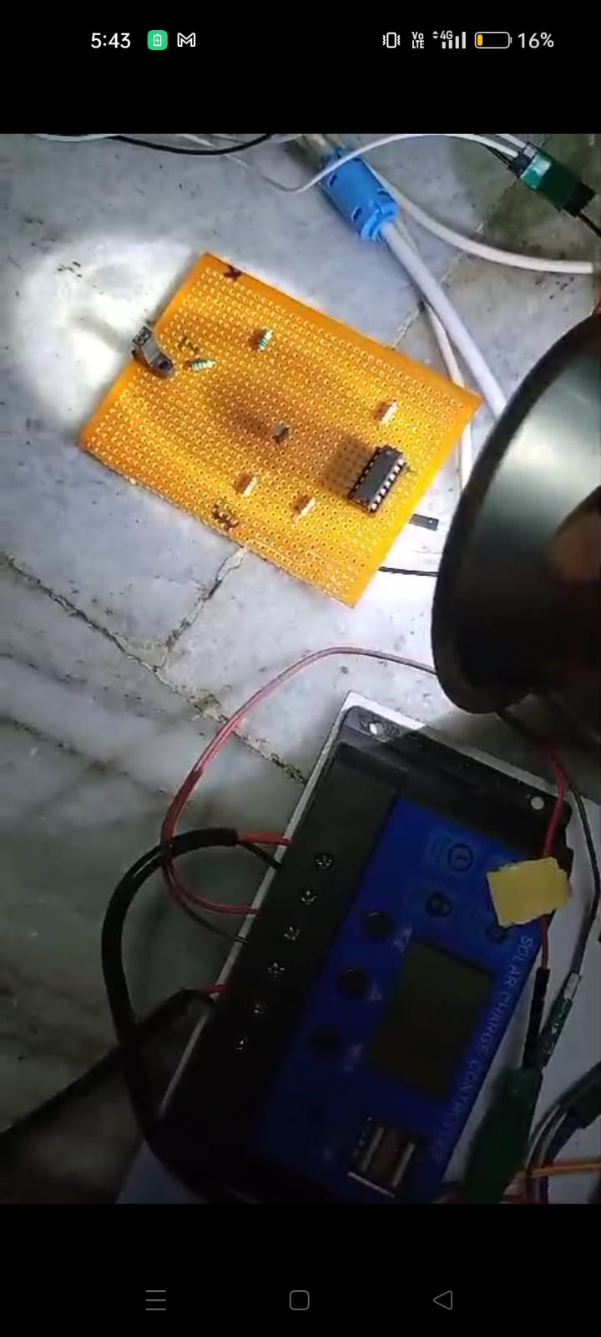
Results and Testing
Solar Tracking Snapshot:
Light Fidelity (Li-Fi) Snapshot:
Displays real-time alignment of the solar panel based on LDR sensor inputs, with the stepper motor adjusting the panel position according to sunlight intensity.
Shows data transmission through LED light, with the receiver decoding the signal accurately under controlled lighting, proving reliable short-range wireless communication.

Slide 13
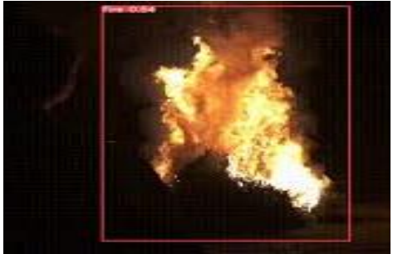
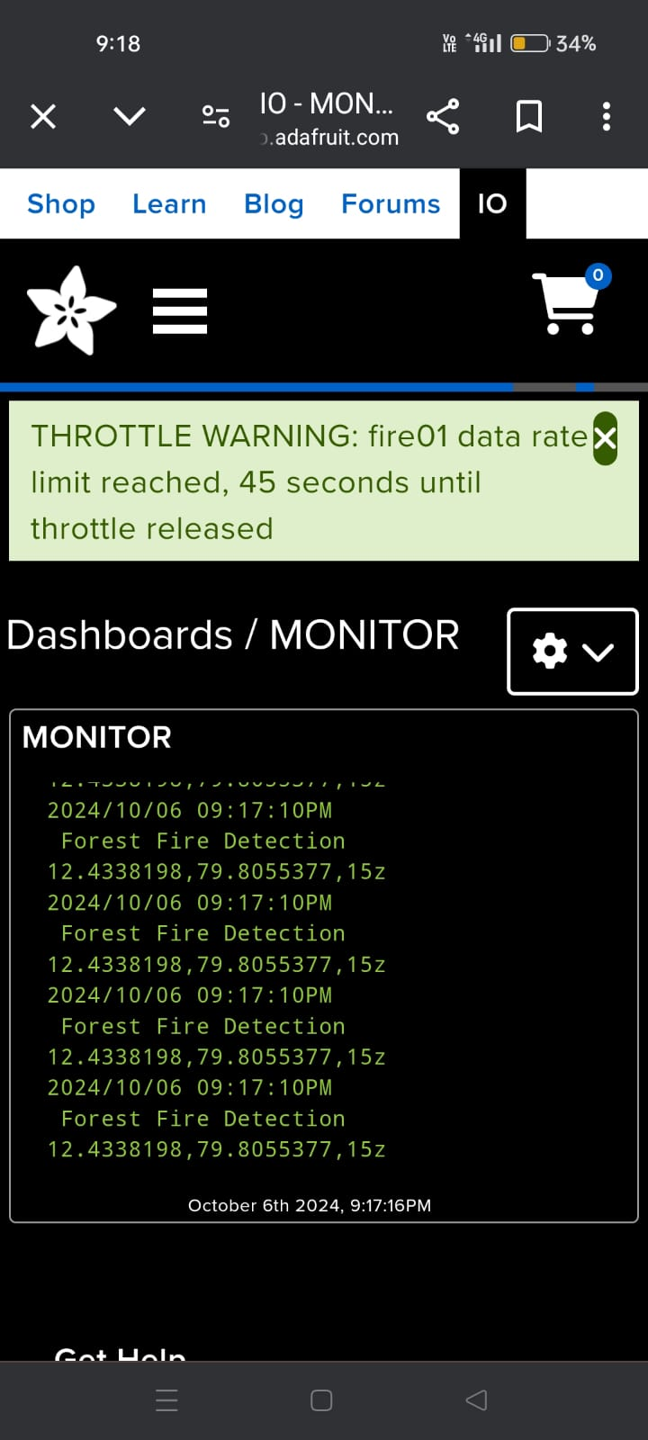
Results and Testing
Fire Detection Snapshot
Dashboard Alert Snapshot:
Captures the output of the YOLO-based fire detection system identifying flames in a test environment, with bounding boxes marking the detected fire regions.
Highlights the alert system on the dashboard triggered by fire detection, showing real-time notifications and system status updates for user awareness.

Slide 14
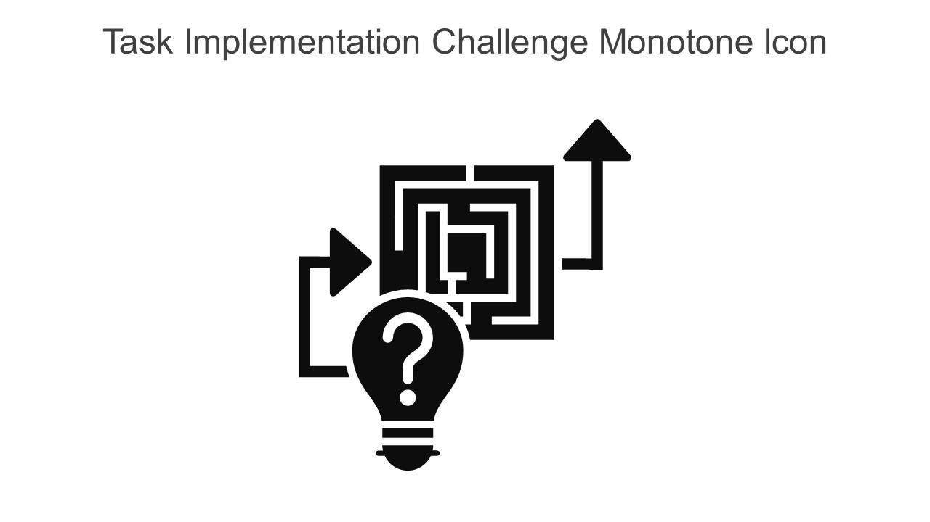
Challenges Faced
Faced difficulty in integrating solar panel with stepper motor for tracking. Resolved by calibrating sensor thresholds & optimizing the control code.
YOLO model showed low accuracy in fire
detection due to poor lighting and noisy
background. Resolved by retraining the
model with improved datasets and applying
preprocessing techniques.
Li-Fi transmission was unstable because of ambient light interference. Fixed by implementing frequency modulation and adjusting LED intensity.
Managing time between academic activities and the project was challenging. Overcame this by following a weekly plan and breaking tasks into smaller goals.

Slide 15
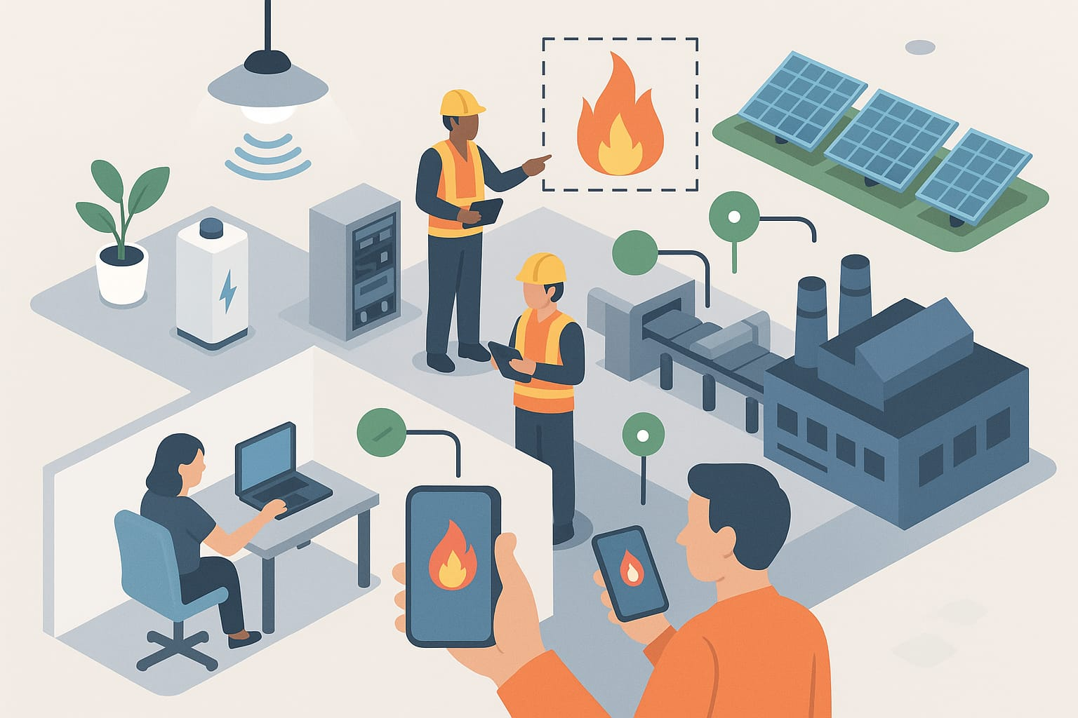
Future Enhancements
Integrate real-time mobile app monitoring for Li-Fi data transmission and fire alerts.
Replace lead-acid battery with lithium-ion for better energy efficiency and longevity.
Implement YOLOv8 for enhanced fire detection accuracy and faster processing.
Optimize energy usage by incorporating smart sensors that activate the system only when needed.
Plan to scale the system for industrial-level automation and multi-zone monitoring.
Future deployment includes solar farms, warehouses, and remote factories for sustainable, wireless communication and safety.

Slide 16
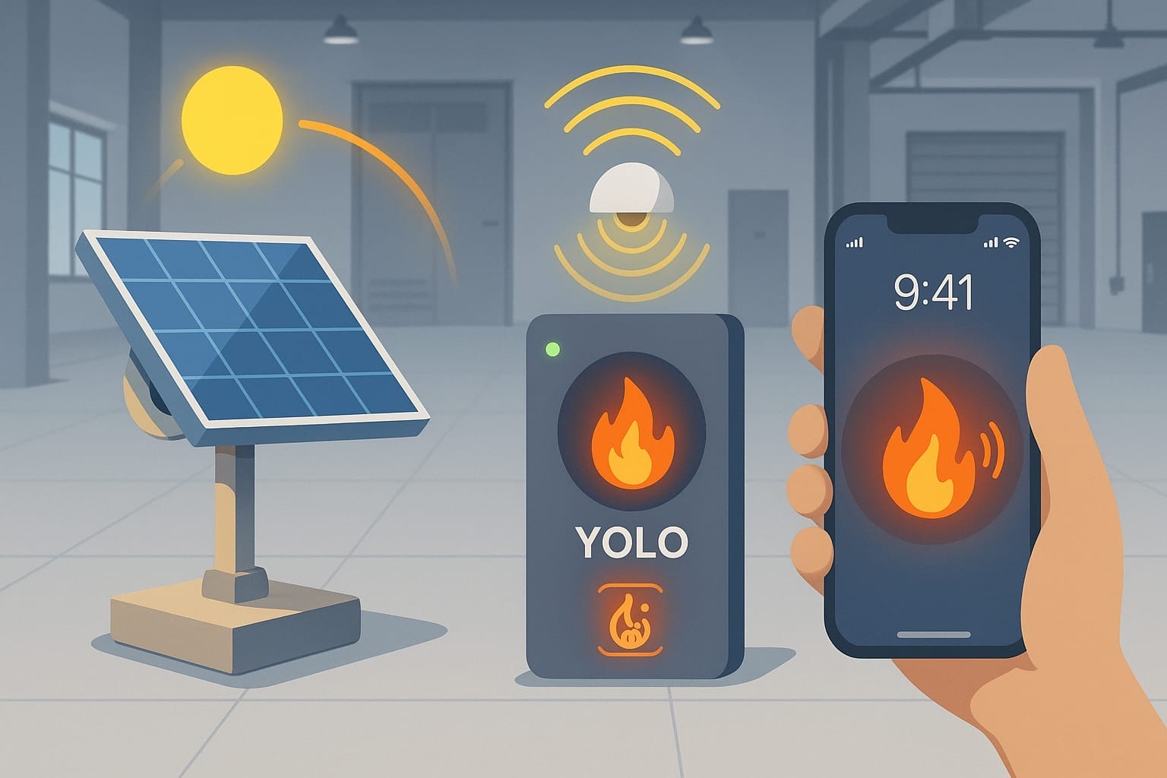
Conclusion
Successfully developed an integrated system combining solar tracking, Li-Fi communication, and fire detection using YOLO.
Achieved real-time solar panel alignment, stable data transmission via Li-Fi, and accurate fire detection in controlled environments.
Gained hands-on experience in working with Arduino, sensors, machine learning models, and embedded systems.
Improved skills in hardware-software integration, teamwork, problem-solving, and project planning.
This project demonstrates the potential for smart, sustainable, and automated solutions in industrial and remote environments.

Slide 17
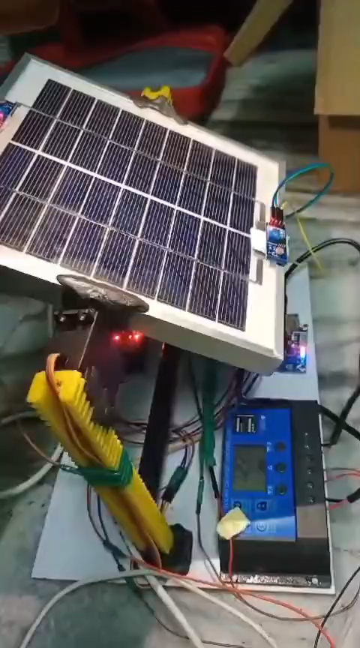
Demo Video of Project

Slide 18
References
[1] Kumba, K., Upender, P., Buduma, P., Sarkar, M., Simon, S. P., & Gundu, V. (2024). Solar tracking systems: Advancements, challenges, and future directions: A review. Energy Reports, 12, 3566-3583. https://doi.org/10.1016/j.egyr.2024.09.038
[2] Mukku, V. D., Lang, S., & Reggelin, T. (2019). Integration of Li-Fi technology in an industry 4.0 learning factory. Procedia Manufacturing, 31, 232-238. https://doi.org/10.1016/j.promfg.2019.03.037
[3] Kouhini, S. M., Kottke, C., Ma, Z., Freund, R., Jungnickel, V., Müller, M., ... & Linnartz, J. P. M. (2021). Li-Fi positioning for industry 4.0. IEEE Journal of Selected Topics in Quantum Electronics, 27(6), 1-15. https://doi.org/10.1016/j.promfg.2019.03.037
[4] Talaat, F. M., & ZainEldin, H. (2023). An improved fire detection approach based on YOLO-v8 for smart cities. Neural Computing and Applications, 35(28), 20939-20954. https://doi.org/10.1007/s00521-023-08809-1

Slide 19

Thank You

